Slide 1
Healthy Belly
Mohammad Bharoocha
Josue Rodriguez
Mateo Perez
Hassan Ishmam
Priyanshi Vaishnav
Nisal Gamage

Slide 2
Sprint #2 Overview
Completed user manual
Updated our Epic 3 by adding a new User Story that correlates to the UI
Continued to work and develop our UI
Continued to work on Backend Servers and Cloud
Notes:
Hassan

Slide 3
Document Updates
Business Requirement Document:
New Persona to match our User Stories in reference to simple UI
Management Plan:
No Updates
Project Requirement Document
Added a new user story “Simplicity of UI” to Epic 3
Notes:
Priyanshi

Slide 4
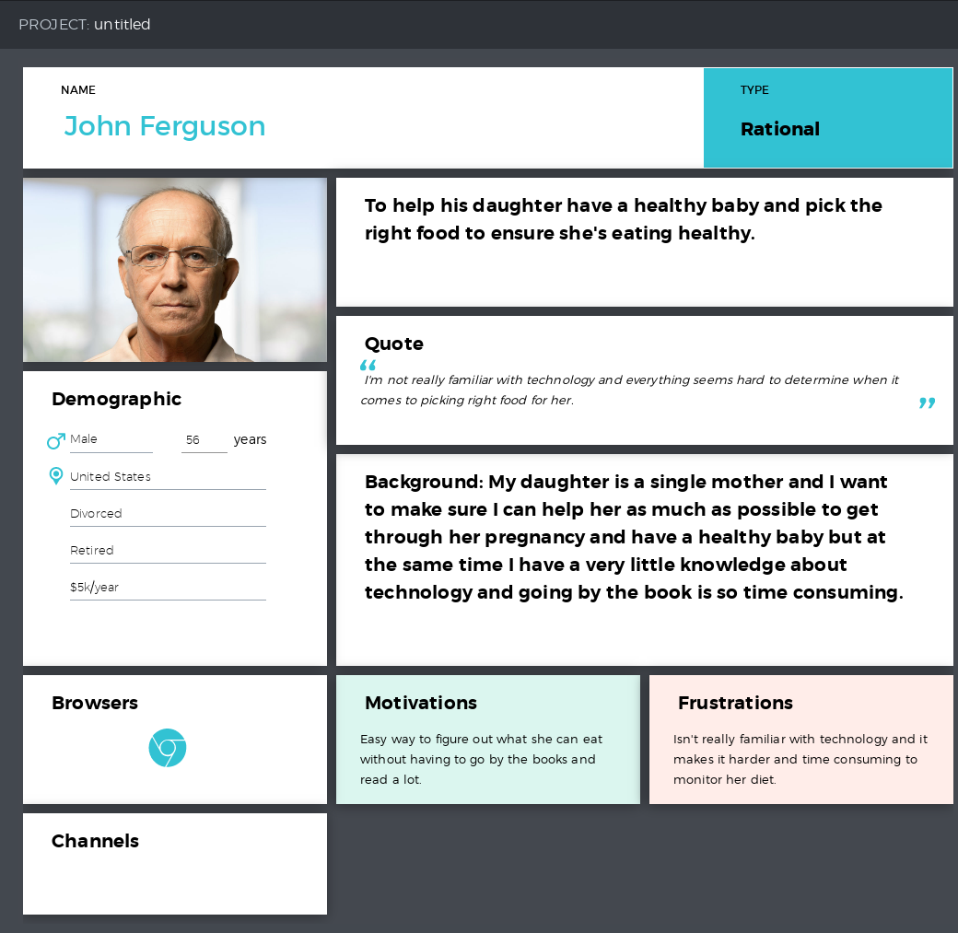
The most significant user story : Simplicity of UI
As a user I want a simple application that isn’t as complicated in terms of technology and simple to use but efficient at the same time.
Healthy Belly’s simple UI enables the user even with little/no knowledge of technology to access the app and use it efficiently. Our UI really comes in handy because of it simple layout easy to understand and use.
This persona hits our Epic #3 : Information
This corresponds to the code of UI.
Notes:
Pri

Slide 5
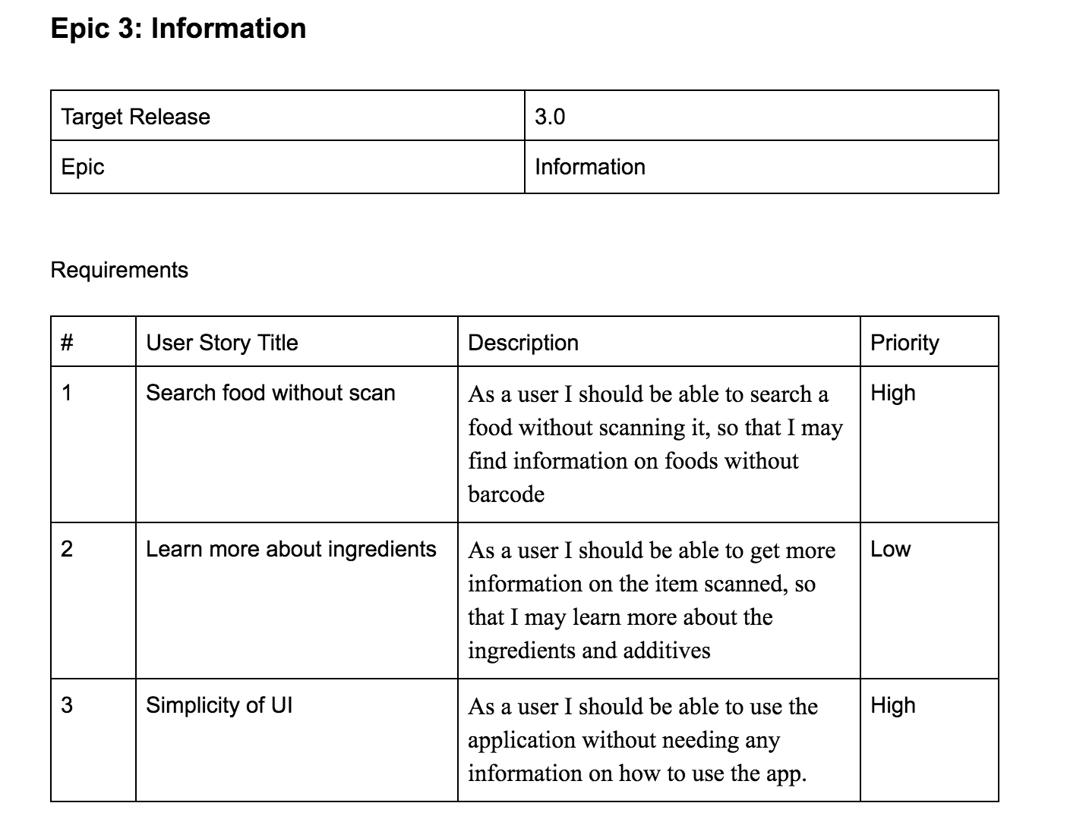
Epic 3 Update : Simplicity of UI
Notes:
Priyanshi

Slide 6
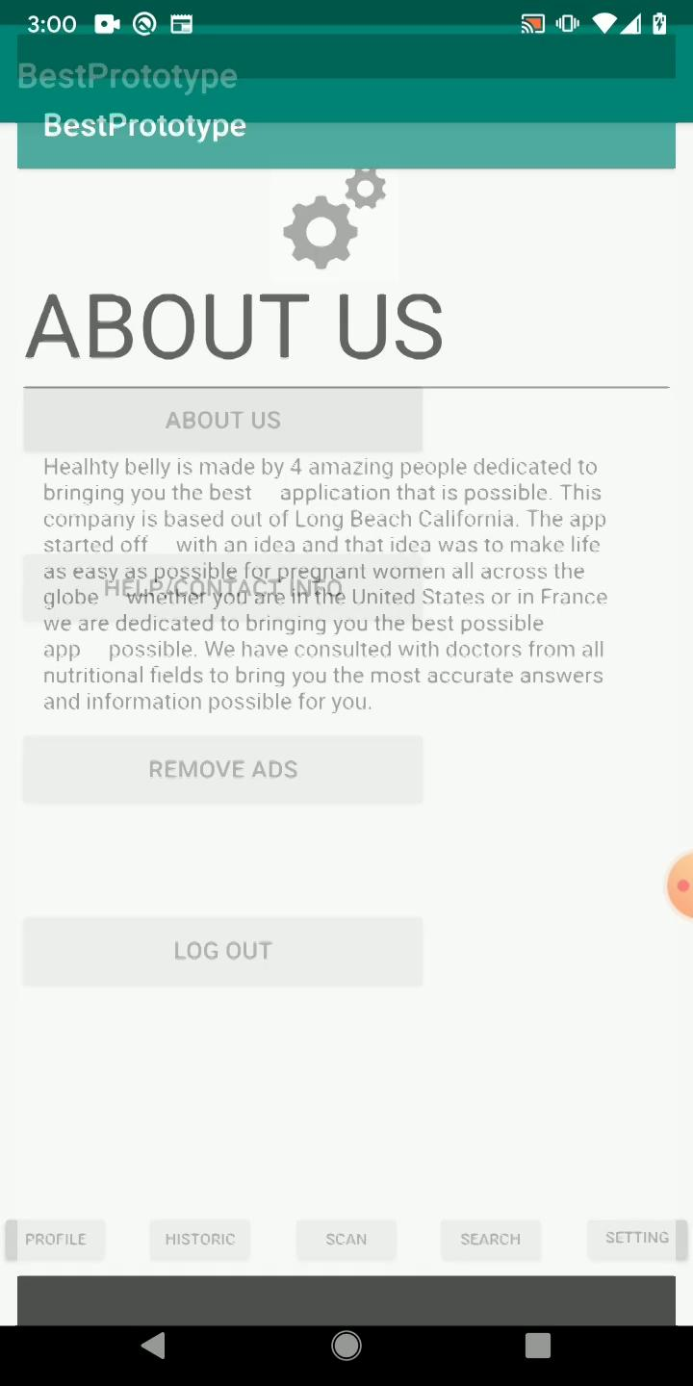
Demo
Notes:
Josue

Slide 7
User Accessibility
User requires 3 clicks maximum
Register: If the user wants to register, they will simply click on the register button which will redirect them to google login page. After the user logs in, it will ask the user for permission to grant us access, which will require 3 clicks
Login: If an existing user wants to login, it will redirect them to google’s login page. Once they put the username and password, they will be good to go (2 clicks)
Scan: This is the most significant task of this app. As soon as they open the app, it will launch the camera and the user can click on the scan button, which will require just 1 click.
Edit info: The user will go to their profile and click edit info. Then they edit whatever they want and hit save, which will require 3 clicks.
Notes:
Hassan

Slide 8
Coding
Platform:
Android
Coding Language for Main Server:
Javascript
Database:
MySQL
Front-End Language
Java
Notes:
Hassanhassan

Slide 9
Machine Learning
Google’s Vision API
It can read data from any image
After scanning the barcode, the app will use vision API to look up similar items
Then the app will analyze those items and suggest the user a better alternative if there is any
Notes:
Hassan

Slide 10
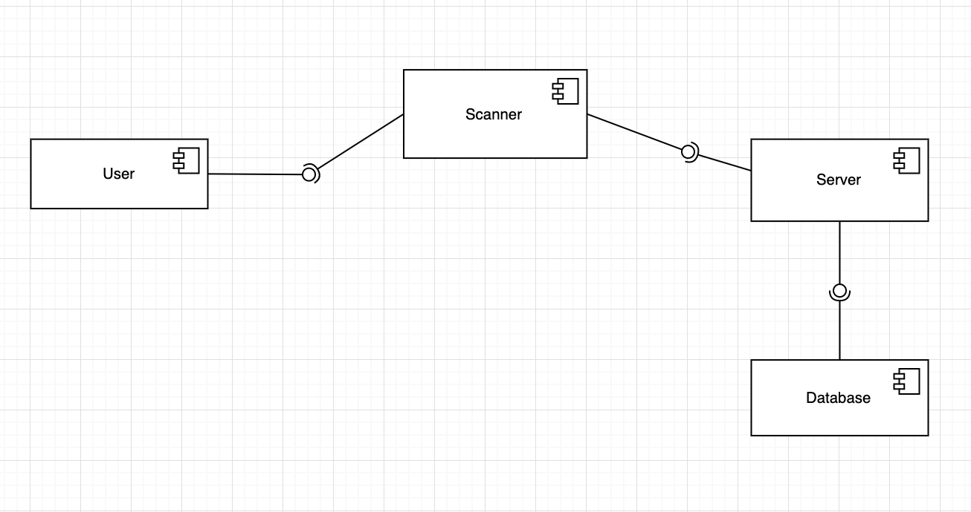
Component Diagram
Notes:
Hassan

Slide 11
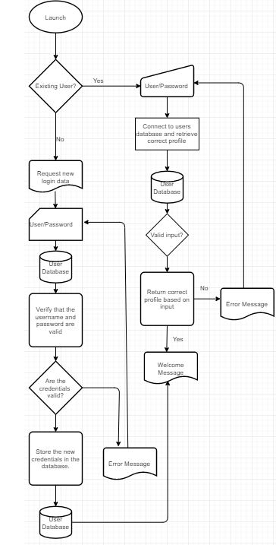
User Login informational flow
Where it all begins...
We want to make sure our users are able to access their own personalized profile in a fast and smooth way
Notes:
Mateo

Slide 12
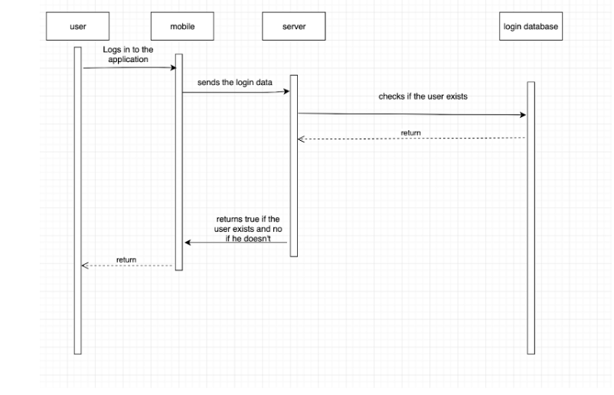
User Login Sequence
Notes:
Mateo

Slide 13
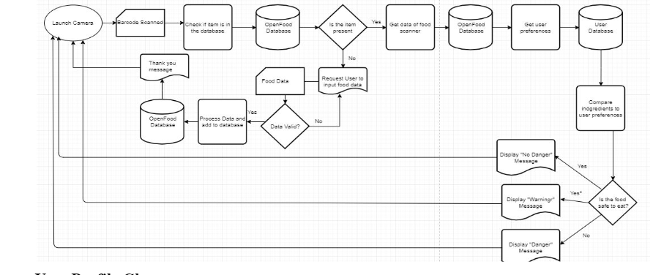
Scanner Informational Flow
Notes:
Mateo

Slide 14
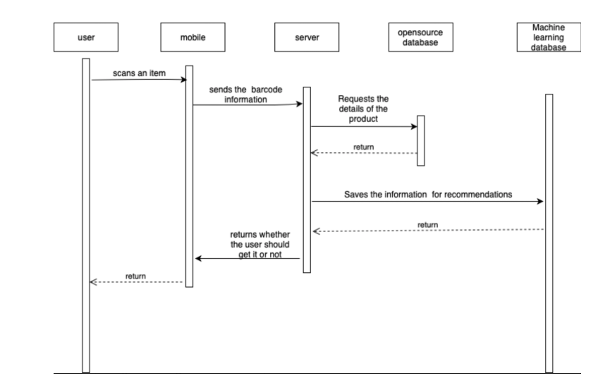
Scanning Sequence Diagram
Notes:
Mateo

Slide 15
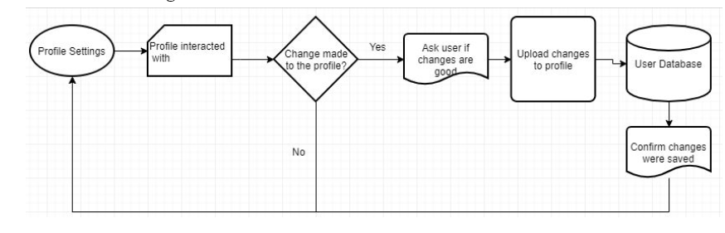
User Profile Change Informational Flow
Notes:
Mateo

Slide 16
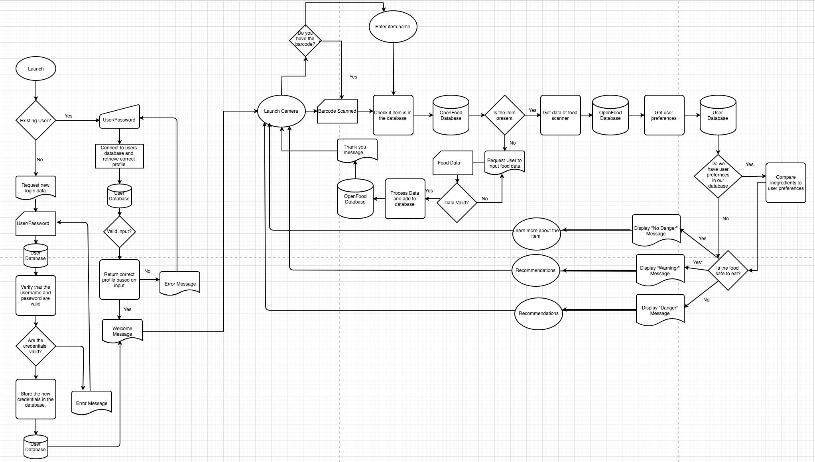
Activity Diagram
Notes:
Pri

Slide 17
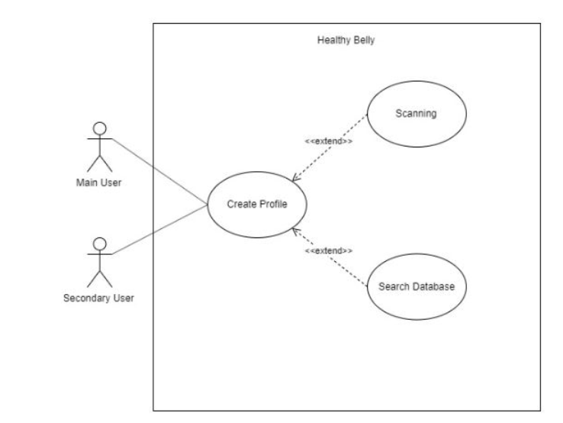
Use Case Diagram
Notes:
Mateo

Slide 18
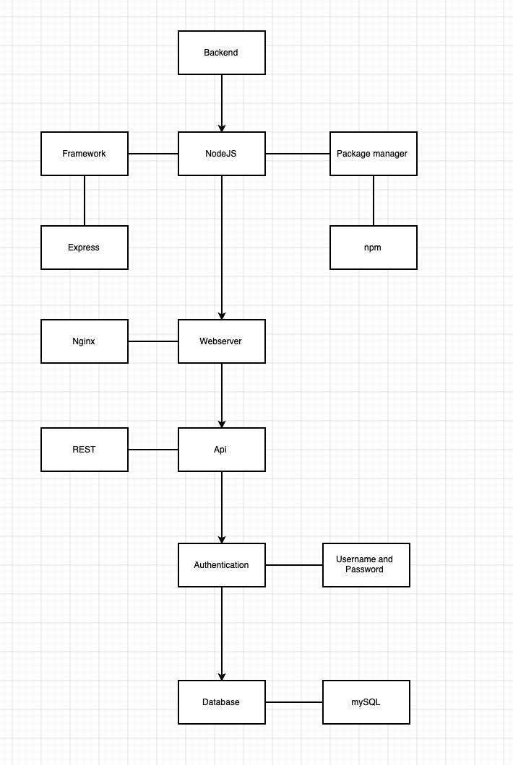
Backend structure
Notes:
Mateo

Slide 19
Architectural Patterns Alternatives
A recap from last sprint:
We selected Layered Architectural Pattern and Client-Server Pattern
LAP: Breaks down tasks into subtasks. Each layer provides services to the next layer.
C-S: Our Servers will provide services to multiple Clients.
We considered Model-View-Controller
Model would handle Core functionalities and data, View handles the information displayed to the user, and Controller handles user input.
We did not pursue this Pattern since MVC is outdated, has development issues, and is complex
Notes:
MHB

Slide 20
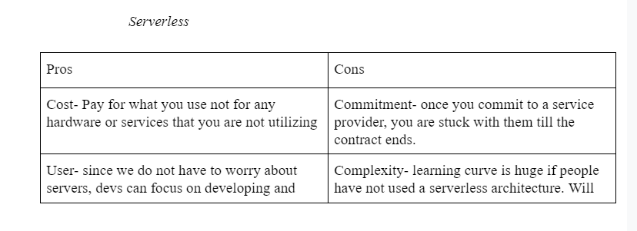
Server Choice
Notes:
MHB

Slide 21
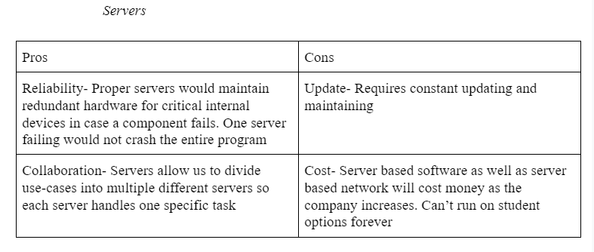
Server Choice
Notes:
MHB

Slide 22
Why AWS for Serverless
Ease of Use:
Amazon Web Services is the easiest to learn and use due to the many resources provided by Amazon
No Capacity Limits
Can change your capacity based on what you need. If more, increase capacity, if less, go less! You pay for what you use
Provides Speed and Agility
Provides tools which helps to reduce the time we spend on a task such as Auto Scaling, AWS Tools and Elastic Load Balancing you can select them on the basis of your demand.
Secure and Reliable
Protects the privacy by storing in AWS data centres. AWS infrastructure is designed to keep your data safe no matter what size of your data is. It just scales with your AWS cloud usage
Notes:
MHB

Slide 23
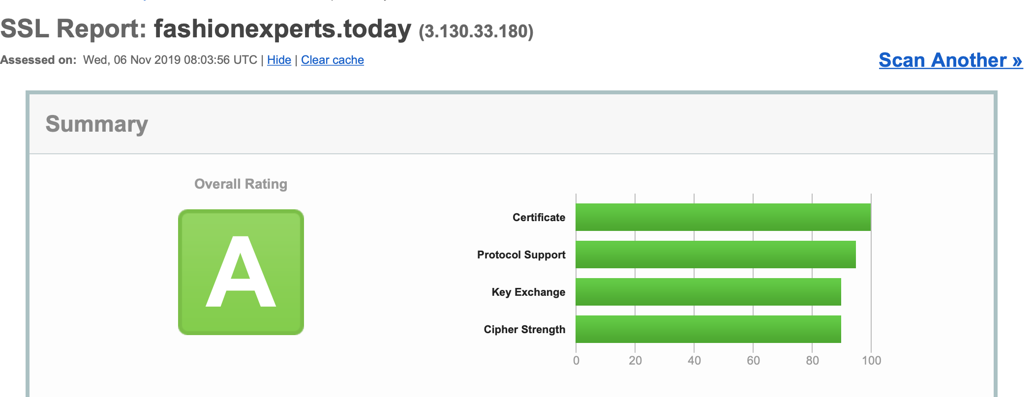
SSL Report
Notes:
NISAL

Slide 24
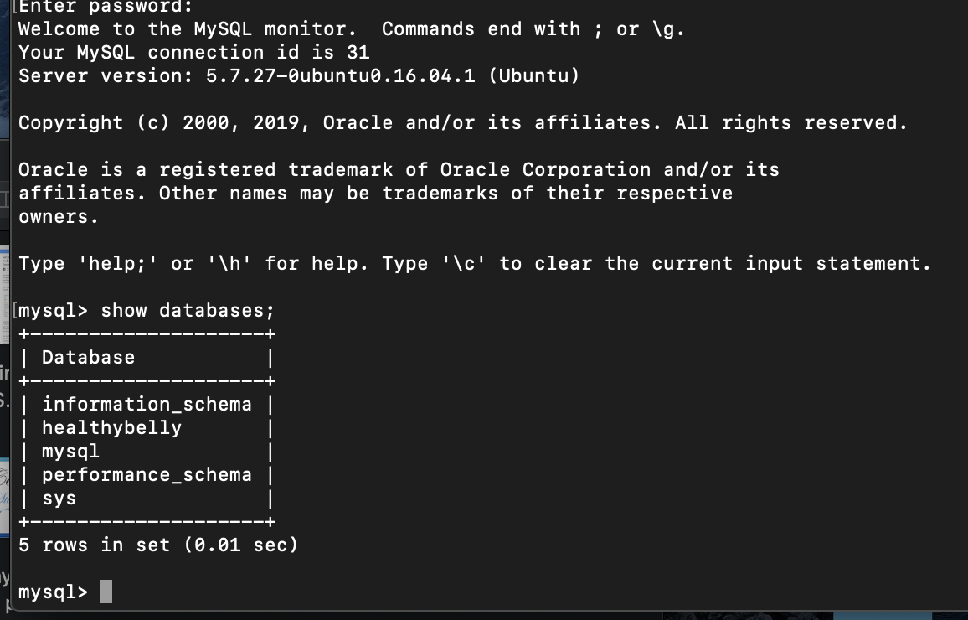
Databases testing
Notes:
NISAL

Slide 25
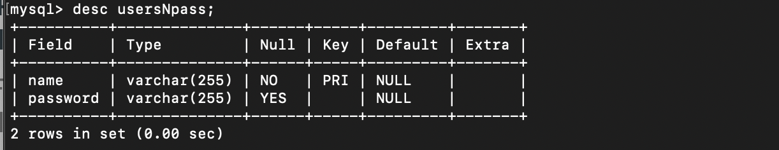
Database table
Notes:
NISAL

Slide 26
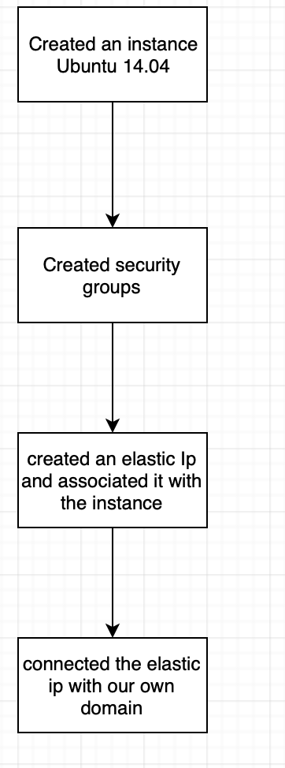
Cloud system
Notes:
NISAL

Slide 27
Implementation
https://fashionexperts.today
https://fashionexperts.today/uNp
Notes:
NISAL

Slide 28
Sprint Retrospective/Future Goals
This Sprint was a tad bit slow, primarily due to the Machine Learning Homework. The goals we set were met but we could not go above and beyond
Future:
Continue working and developing UI, Plan on completing the UI by end of Semester
Complete a Dummy Database so we can implement a small scale database with our UI and start testing with data.
Notes:
MHB

Slide 29
End of Presentation!
Thank you for your time!
QUESTIONS??
Notes:
MHB

Slide 30

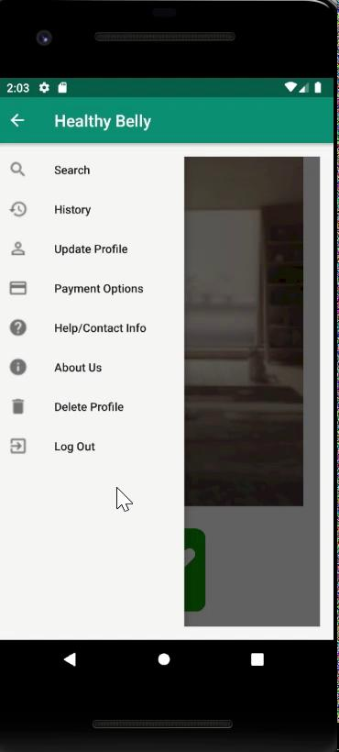
WE BACK AT IT AGAIN WITH ANOTHER SURPRISE!
Notes:
MHB

Slide 31
End of Presentation!
Now it truly ended...
QUESTIONS??
Notes:
MHB

